Slide 1
Exploratory Data Analysis

Slide 2
Exploratory Data Analysis
Business Understanding
Data Collection
Exploratory Data Analysis
Data Preparation
Modelling and Deployment

Slide 3
Exploratory Data Analysis
Exploratory Data Analysis (EDA) helps :
Understanding variables and their structure
Relationship between variables to prepare assumptions for ML algorithm
Recommends data pre-processing and feature engineering steps essential for model development

Slide 4
Exploratory Data Analysis
EDA Components
Data Summary
Data Visualization
Data Cleaning

Slide 5
EDA Steps
Basic Description of data set
Univariate Analysis
Bivariate Analysis
Missing value treatment
Outlier treatment

Slide 6
Basic Description
Basic Description
Dimension, variable name
Data Schema Check
Snapshot of sample of data
Basic summary of complete data

Slide 7
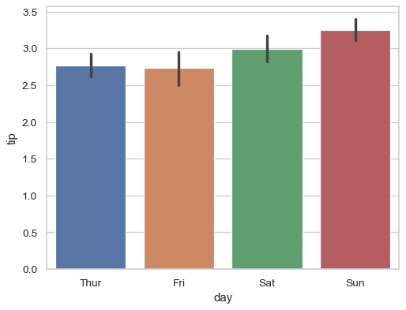
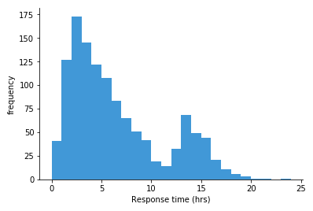
Univariate Analysis
Univariate Analysis
Categorical Columns
Category Grouping
Visualization
Numerical Columns
Visualization
e.g. Unmarried / bachelor into unmarried
Inspection of Outlier/skewness

Slide 8
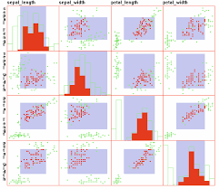
Bivariate Analysis
Bivariate Analysis
Numerical/Numerical Columns
Correlation check
Visualization
Categorical/Numerical Columns
Visualization
E.g. multicollinearity
Multivariate Plots
Multivariate Plots
Distribution of variables (e.g. pivot tables)

Slide 9
Missing Value Treatment
Missing data, or missing values, or simply black values occur when no data value is stored for the variable in an observation.
Probable reasons for missing values :
No response in a survey by respondent to any questions due to personal or technical reasons
Some items are more likely to generate a nonresponse than others: for example items about private subjects such as income
Impact :
It might lead to a biased or incorrect analysis and therefore impact a business decision
Once a model is developed and deployed, having missing values in new records will not allow predictions
Many packages in python do not work if data contains missing values

Slide 10
Missing Value Treatment
It is represented by many ways depend on tools:
R language
NA (not available)
Impossible values (e.g., dividing by zero) are represented by the symbol NaN (not a number)
Python
None
NaN

Slide 11
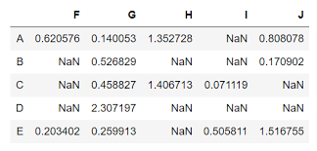
Missing Value Treatment
Example of missing values in python

Slide 12
Missing Value Treatment
Treatment of missing values :
Ignore and continue
Remove rows which contains missing records
Remove columns which contains missing records
Imputation (Filling)
Using central statistics (mean /median / mode)
Using previous or next values (forward and backward fill)
Using modelling approach (Modelling missing value column as a target variable)
KNN imputation (Find nearest attributes based upon Euclidean distance)

Slide 13

Outliers
A data point that differs significantly from other observations Or most extreme with respect to remaining of the population.
You will also find ‘anamoly’ in place of outlier
Probable reasons for outliers :
Variability/Defects in measurement instrument
Experimental error (knowingly or unknowingly)
Technical error during data collection

Slide 14
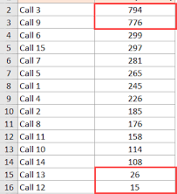
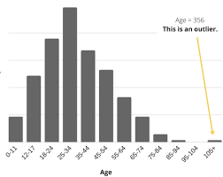
Outliers
Notes:
https://trumpexcel.com/find-outliers-excel/

Slide 15
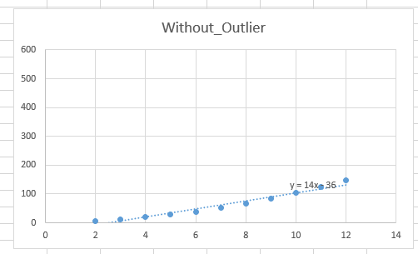
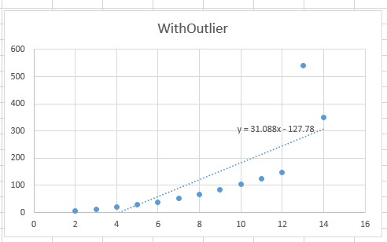
Outliers
Impact :
It can change the model equation completely i.e. bad prediction or estimation
Cause anomalies in the results obtained through data analysis.
Notes:
https://discuss.analyticsvidhya.com/t/effects-of-outliers-on-regression-model/2403/2

Slide 16
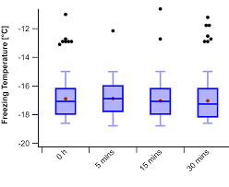
Identify Outlier
For a large datasets visualization of numerical data helps to identify if data contains outliers or not
Notes:
https://www.wavemetrics.com/forum/igor-pro-wish-list/box-plot-outliers-percentile-level-rather-15-x-iqr

Slide 17
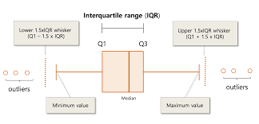
Identify Outlier
Objective Approach :
Intuitive and business judgment approach : Decide a meaningful extreme
Check visualization and decide a cut off
IQR Formulae (Turkey Method):
Point beyond the upper boundary of Q3+1.5 IQR
and the lower boundary of Q1−1.5 IQR.

Slide 18
Treatment of Outlier
Ignore and continue
Replace with Median value
Replace with 99th percentile or 1st percentile value.
Replace with manual values based upon business judgment

